Slide 1
Cassandra project
Corso Fondamenti di sistemi informativi

Slide 2
Why Cassandra
RDBMS does not work and scale well for big data:
Replication: ACID does not hold anymore
Third Normal Form doesn’t scale
Unconsistent result
Queries are not predictable
Users want a fast system
Must denormalize data
Avoid disk seek
Sacrifice disk space to accept redundancy
Client
Master
Slave
Replication lag
Sharding is a nightmare
High availability is apparent
Joins and aggregation are off limits
Data is scattered in shardes
Using 2’ indexes hit every shard
Add a shard is painful: manually move its assigned data
Edit every shard manually in case of schema changes
If a master fails, its slaves are useless until the master is up again
Manage multiple data centers is a disaster
Frequent downtime
Changes to DB settings
Updates
Drive or power supply failures
Client

Slide 3
What is Cassandra?
Cassandra is a fast distributed database built for high availability and linear scalability
Features:
Predictable performaces: low latency and high scalability, even using 2, 10, 1000 nodes
No single point of failure: it’s a peer-to-peer technology, no master/slave
Supports multi data centers: it can withstand an entire data center failure
Commodity hardware: using many low-cost machines to scale horizontally and not vertically
Easy to manage operationally
NOT a direct replacement for RDBMS: it is necessary to adapt the model
Notes:
Apache cassandra è un database distribuito veloce costruito per alta disponibilità e scalabilità lineare. Vogliamo avere performance prevedibili dal bd, bassa latenza e scalabilità: quando scaliamo con 2 100 1000 nodi abbiamo le stesse performaces. Non esistono singoli punti di fallimento: peer to peer, non ci sono master slaves o relazioni tra nodi. Possiamo riuscire a sopportare il fallimento di un intero data center. Usiamo tante macchine a basso costo: scalare orizzontalmente e non verticale.
Facile da manterere anche se i nodi crescono. Non è un sostituito diretto di un rdbms, si deve lavorare un po’

Slide 4
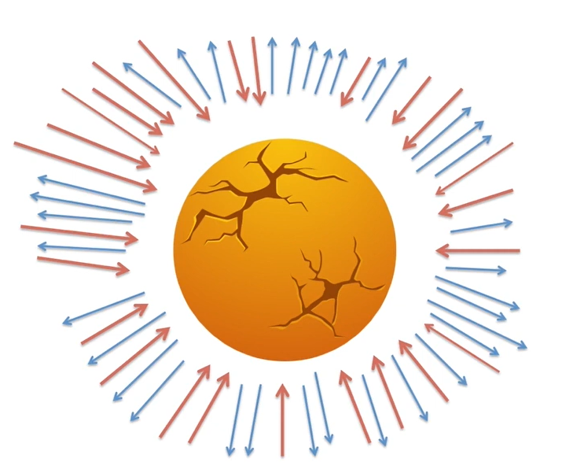

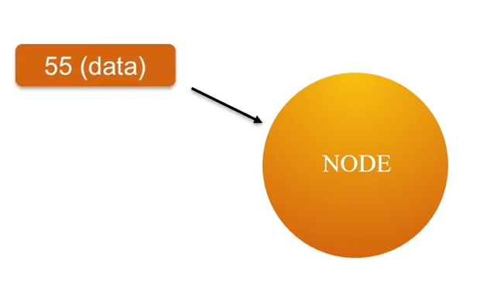
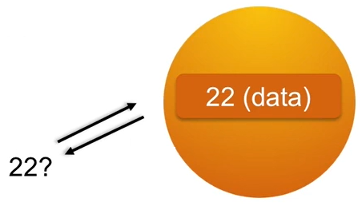
Nodes
Cassandra is a distribuited system made up of nodes. Cassandra runs in every node in a JVM (Java Virtual Machine)
Typically, a node runs on a single commodity machine or VM
A node is responsible for the data that it stores
All the data is stored in a distribuited hash table, and the data itself is hashed
When the load becomes too heavy, we just add more nodes
Write operation: the data key is 55
Read operation: the data key to find is 22

Slide 5

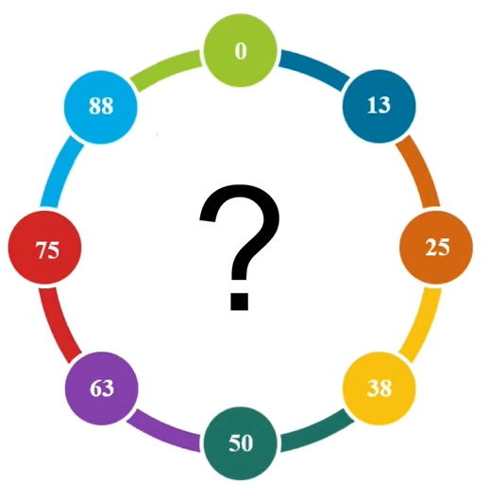
ring
Every node manages its own data: what happens when a new record comes?
New data comes to a node, that will become the coordinator that handles the request
Every node can be a coordinator
The coordinator node sends the data to the correct node that stores the partition
How does a node know where to send the data? Each node is responsible for a range of data: token range
Then when the data is sent, the coordinator sends an acknowledge to the client
59 (data)

Slide 6
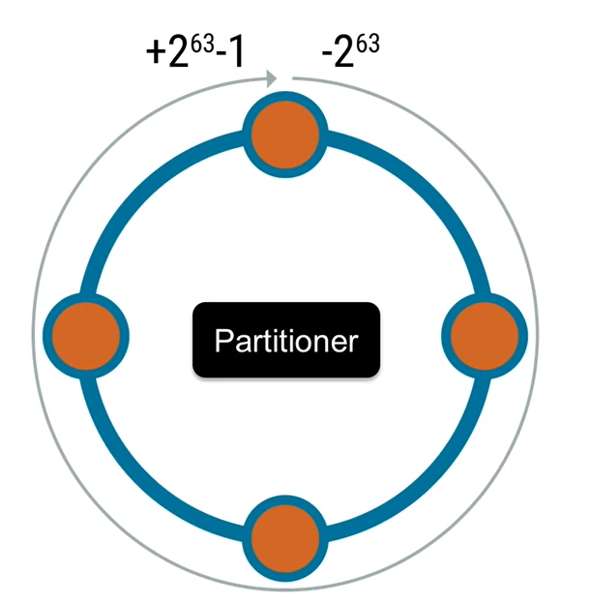
Ring
The real range goes from -2⁶³ to 2⁶³-1
How are the token distribuited?
The partitioner determines how the data is distributed across the ring
If it gets mess up, data will land to hotspots in the ring: some nodes will be overloaded and some not
Using an appropriate hash function is important for distribution, like MD5
Example of overload

Slide 7
Joining the cluster
Nodes join the cluster by communicating with any node
Other nodes calculate where it fits in the ring and streams their data to the new node
There are 4 states to each node: joining, leaving, up and down
When the node is in joining mode it is still receiving data, but it is not fully joined, so not ready for reads
The node is online! No downtime
Finally, when the node is up, it is ready
Remember: horizontal scaling is preferable, so adding nodes is good practice rather than improve a single machine

Slide 8
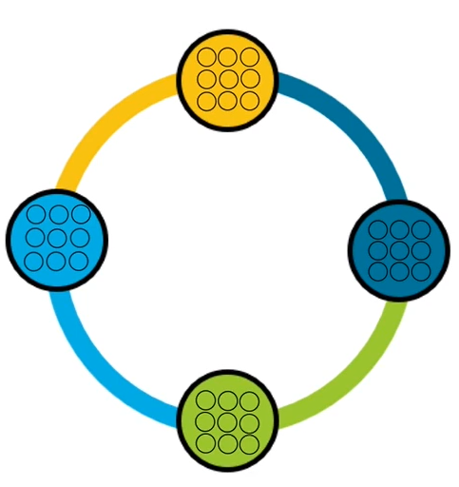

Vnodes
Adding or removing nodes in the cluster takes time to stream the data and calculate the new ring range
Using Vnodes, each physical node act like several smaller virtual nodes
A node is responsible for several smaller slices of the ring instead of one large slice
Using a consistent hash ensure that all the nodes will have the same amount of data
When a node is inserted: instead of taking over one node’s entire token range, it takes several smaller ranges from each other nodes, that will stream in parallel
Without VNodes
With VNodes

Slide 9
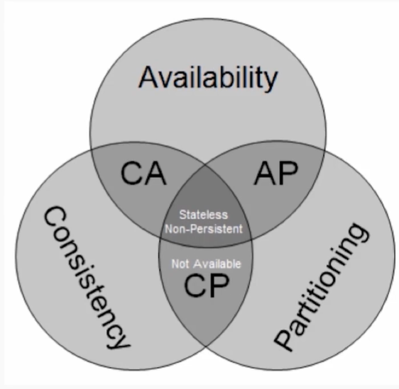
CAP tradeoffs
Impossible to be consistent, available and have network partitions
Latency between data centers makes consistency impractical, especially when they are in different continents
Cassandra chooses Availability and Partition tolerance over Consistency
However, consistency and availability are tunable

Slide 10
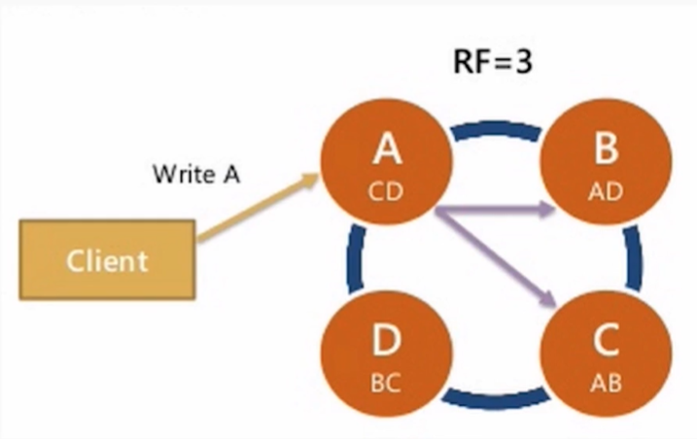
Replication
Replication factor = RF = how many copies of each piece of data should be in the cluster
- Data is replicated automatically based on the RF
- Data is always replicated in Cassandra
- Replication happens asynchronously and if a machine is down Cassandra has hinted handoff to replay the missed replication when the node is available again
A usual RF is 3
With RF = 3, when a write happens:
A node gets a copy
B node get a copy
C node gets a copy
For a total of 3 replicas

Slide 11
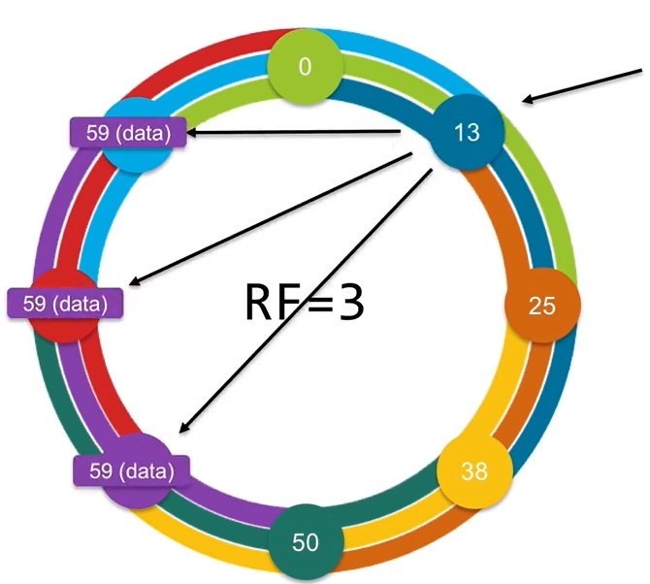
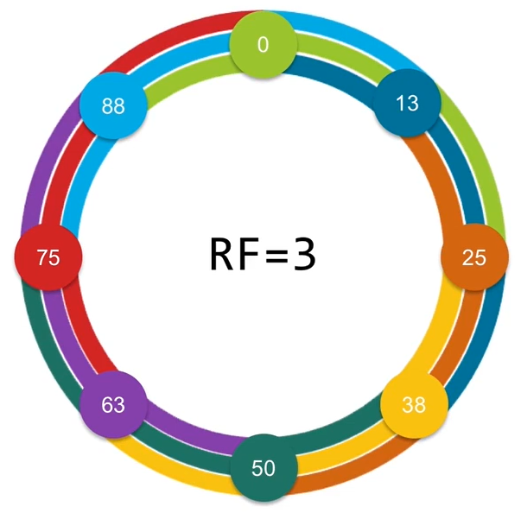
Replication
In case of RF = 3, each node has the neighbor neighbor neighbor data
This data is findable by the coordinator: when writing into the ring we know that is going to be in the right place
Replication also works well with multiple data centers

Slide 12
Tunable Consistency
Consistenct level = CL = how many replicas I need to hear when I do a read or a write before the operation is considered successful
How many replicas for query to respond OK to the client
Defines a query consistency
Two separate values: one for write and one for read
High CL: high consistency but slower, low availability Low CL: low consistency but faster, high availability
In case of read: how many replicas I need to hear before Cassandra gives the data back to the client
In case of write: how many replicas need to say that the data is written to disk before Cassandra replies to the client
Notes:
Si sceglie per sia letture che scritture

Slide 13
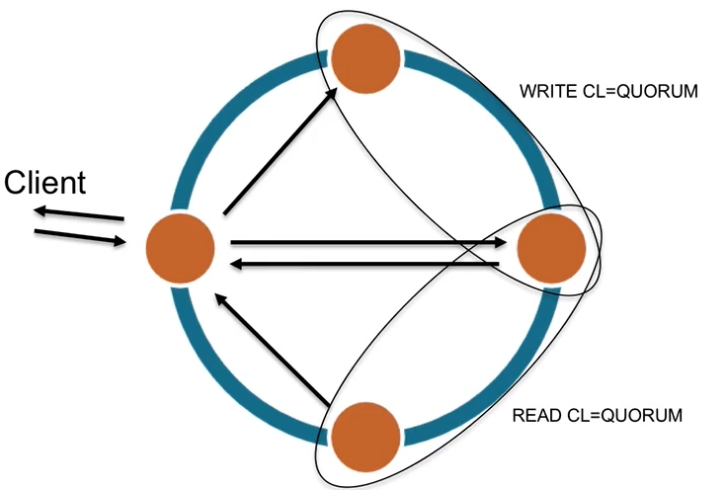
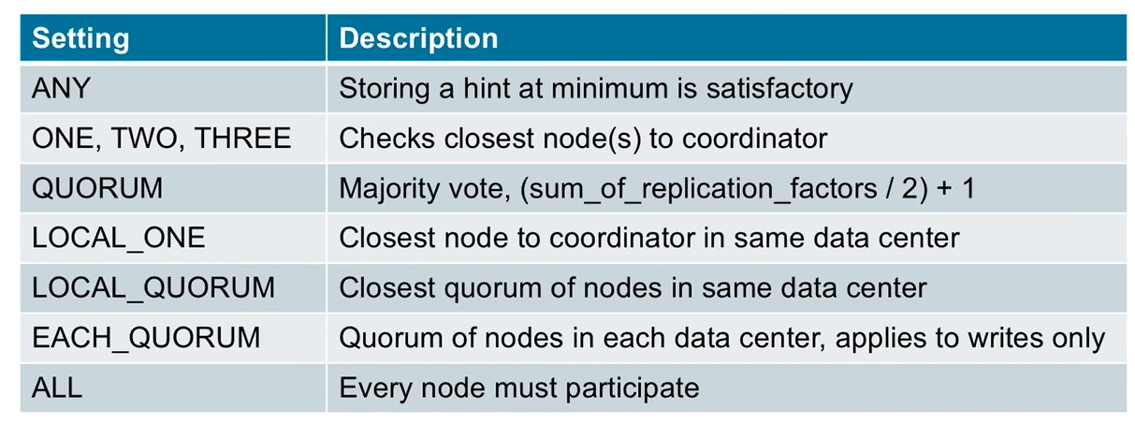
Consistency levels
When using a database, we want strong consistency
It means that we are reading the data that we just put in the cluster
A good place to start is using CL=QUORUM in reads and writes: at least 51% of nodes have to acknowledge the succeeded write or have to return the requested data

Slide 14

Gossip protocol
Gossip is a broadcast protocol for disseminating data across the cluster
Since there isn’t a central server, the peers spread information among themselves
They automatically mantain only the last information
At the end, the entire cluster know the information
Gossip does not cause a heavy amount of traffic

Slide 15
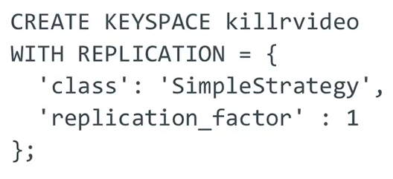

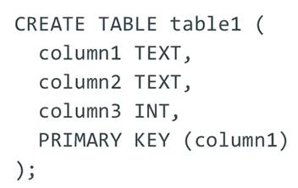
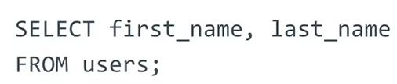
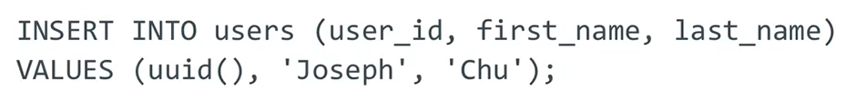
CQL
CQL is the Cassandra Query Language
Very similar to SQL
Keyspaces are similar to SQL schemas and they serve as namespaces that contains tables
Specifies the replication factor
USE command to switch between keyspaces
The rest of the commands are pretty straight-forward if coming from SQL

Slide 16

Primary key
Primary keys are important in relational databases
But in Cassandra they are the most important part of a data model
In Cassandra, a Primary key is composed of:
Partition key(s) – Tells the system in which node is the record
Clustering key(s) – Tells how to order the data that is in the same partition
The first parentheses contain the Partition key(s)
Outside the parentheses there are the Clustering keys: the order is important since in case of equal values in the first clustering key the records are ordered using the second clustering key and so on (if they exist)

Slide 17
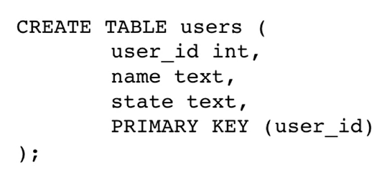
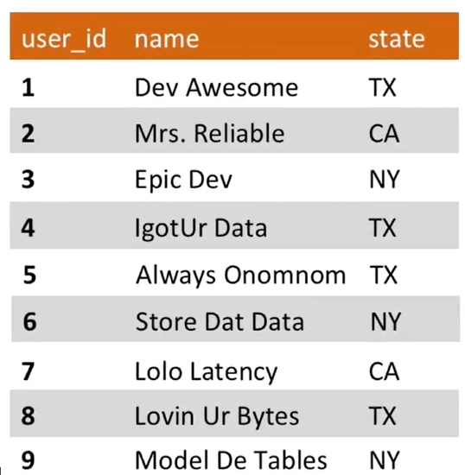
Partitions and partition keys
A Cassandra table is similar to a relational DB table
Notice the Primary key: in Cassandra we want to have fast reads and writes, and to do so we introduce Partition keys
A partition key works as a primary key but also tells the system how to group the data together.
Partitioning correctly is crucial: Cassandra knows exactly where is the partitioned data
Cassandra is application-oriented: to take advantages of its grouping it is necessary to change the data model
Partitioning by user_id is useless since it is an unique field

Slide 18
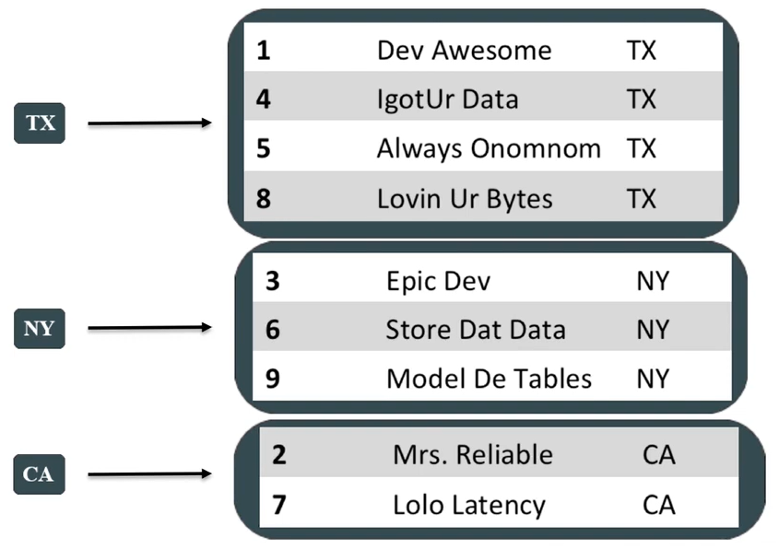
Partitions
In this example, we want to partition by the State field
The query needs to have the State as the logical grouping.
The partition key is how the data is placed on the ring. The key is hashed to determine where to place the data Same partition key = same node = same hash
The choiches made in the data model have a huge impact in the query efficency
To partition like the image, the primary key is:
where the first value is always the partition key. To make a unique primary key, the id is added as clustering column

Slide 19

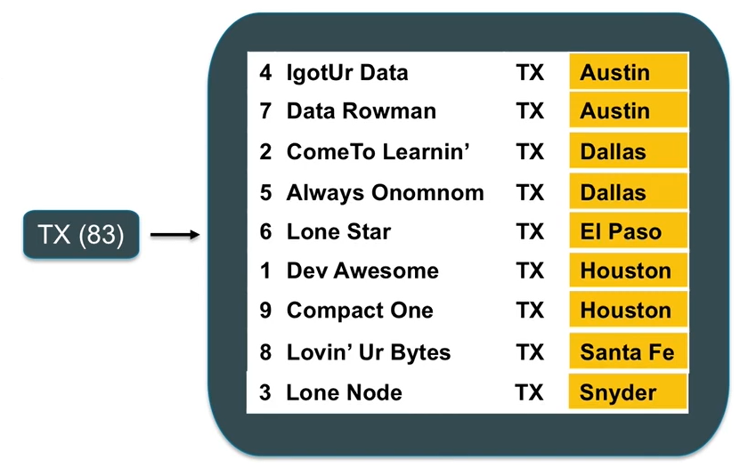
Clustering columns
Clustering columns are the second part of a primary key, and the come after the partition key.
Clustering columns tells Cassandra how to order and put data
When writing, data is going into the disk in the order specified by the clustering columns When reading, Cassandra knows exactly where and in what order it is
It is possible to have more than one clustering column.
If it’s the case, the data is ordered by the first key, then by the second one and so on
The State is the partition key and the City is the clustering column, which is being used to sort the data from TX in ascending order

Slide 20


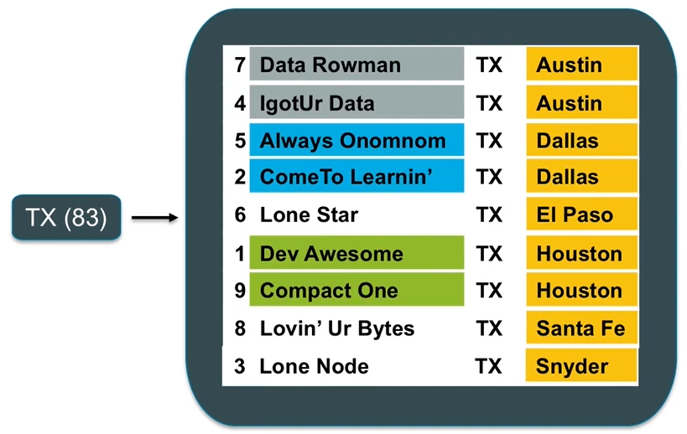
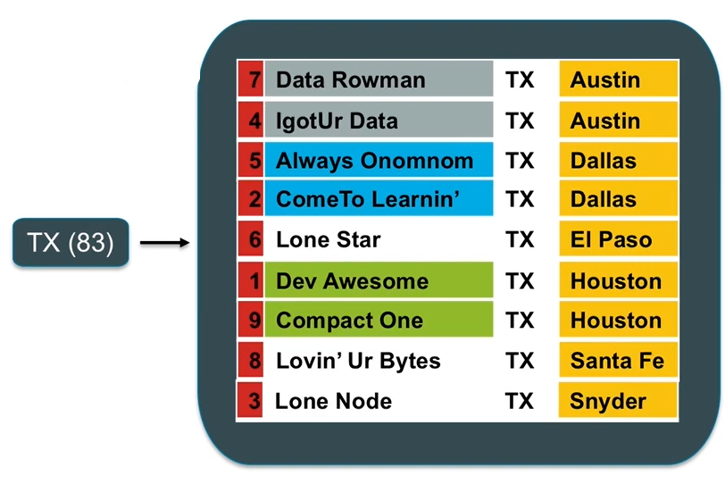
Clustering columns examples
The State is the partition key, the City and the Name are the clustering columns. First order by the city and then order by the name
To make a unique Primary key it is necessary to add a field, the id, which is in the clustering columns (Note: ids are not suitable for distribuited systems, it is better to use uuids)

Slide 21
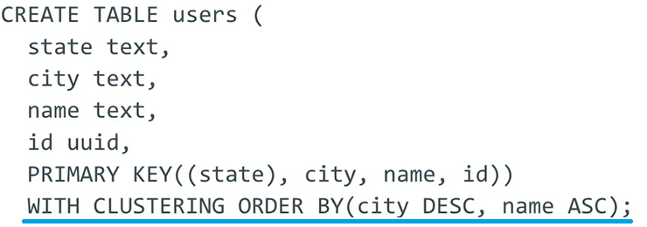
Clustering columns order
The default clustering column order is ascending
It is possible to change the order using WITH CLUSTERING ORDER BY

Slide 22
Querying
Every query should have a partition key: Cassandra needs to know where to look
Inside a partition, you can perform operations (< > =) on clustering columns
When doing equals, it is important to do them in the same order that the clustering columns are presented in the Primary key definition
That is because the data is ordered on disk: Cassandra performs a binary search
If you try to query data and filter it using a WHERE statement by NOT specifying a Partition key, Cassandra will refuse the query
If the Partition key is composed, it is necessary to provide both of them

Slide 23
Oriented to applications
Query oriented in che senso

